Slide 1
What is ‘sex’? Is it a ‘natural’ category?

Slide 2
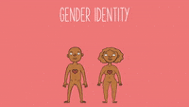
The category of ‘sex’ requires a coherence between a person’s:
1. Chromosomes
2. Hormones
3. Internal organs
4. External organs
Otherwise, where does this category of ‘sex’ lie?

Slide 3
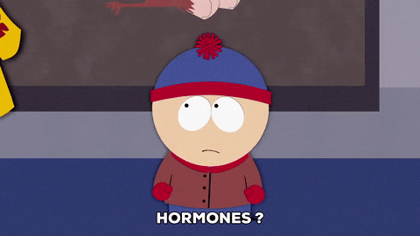
Testosterone
Hormone: Chemicals released directly into our bloodstream, they affect many aspects of our body and growth, our body releases close to 50 hormones

Slide 4
Boys are boys because they have higher levels of testosterone!
EEEEEEEEEEEEESSSSSSSHHHHHHH-SNAAAAAAP
EVERY HUMAN BODY PRODUCES TESTOSTERONE
A testosterone molecule^

Slide 5
Well, okay! But, boys produce more testosterone and the girls with high testosterone are ‘manly’
But did you know? Testosterone is more biologically active in women!!

Slide 6
What causes the release of testosterone and what is it responsible for?
Hormones do not work in isolation. They are affected by factors such as the environment, stress, food, light, exercise, sleep, climate, nature of work and more.
It is now recognized that neurophysiology and hormonal balances are affected by social factors, like anxiety, physical labour, and the level and the kind of social interaction, just as much as social interaction is affected by people's neurophysiology and hormonal balances.
Testosterone is responsible for body hair, deep voice, muscle bulk, and more (but there is contradictory evidence too). T is very dynamic — it affects each muscle uniquely, varies at different points of the day and affects every body differently.

Slide 7
The case of Dutee Chand: The Odisha sprinter had broken national records at the age of 16, and won a bronze medal in the 200m at the age of 18 at the 2013 Asian Championships in Pune. She was supposed to be India’s big hope for an Olympic medal in athletics, but just before the Glasgow Commonwealth Games in 2014 she was dropped from the team because she failed a hormone test. The Athletics Federation of India barred her from participation, because she too had refused to take the pills.
The court found the IAAF had failed to prove natural testosterone provides a significant athletic advantage. You might intuitively assume it does since artificial testosterone is a banned performance enhancer. Natural testosterone is another matter and besides it is hard to quantify the size of any advantage when there are so many variables involved in performance.
Critics have called out the double standards in athletics, as the world had hailed swimmer Michael Phelps as a genetic marvel, since his body produced only half the amount of lactic acid compared to other athletes. Lactic acid causes fatigue, thus he had an upper hand because he could train and exert more without getting tired.
He also had a much larger wing-span, which gave him an advantage while swimming. Yet, his body parts were not scrutinised, nor was he questioned.
A similar situation was faced by Caster Semenya, a south African runner and a 2016 Olympic gold medalist.
In fact, many women of colour are ones to be subjected to these ways of invalidation.
Can you research about more such cases of invalidation and the ways in which the criteria for qualifying as ‘women’ in sports has varied in time??

Slide 8
The internal organs
Testes produce sperms and ovaries produce eggs.
We know of many women and men who either cannot produce sperms or eggs or of women who may not be able to carry babies because in their womb.

Slide 9
Nearly a third of the male population can have 'breasts', and if it is not due to rare endocrinological causes, the condition is perfectly normal. It seems to have no other ill effects than causing 'disgust' but, nevertheless, it is pathologized and made into a disease (gynaecomastia), and when other serious illnesses have been ruled out, the advice given is not to relax and stop worrying, but to undertake surgery, to make that body conform to a mythical norm.

Slide 10
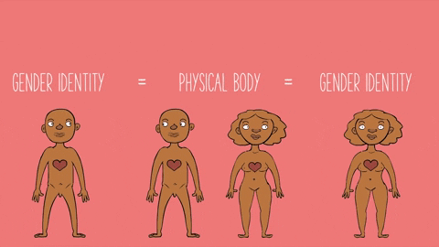
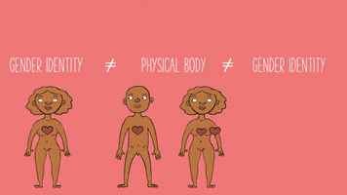
Understanding Cis and Trans
Cis Gender
When the gender you identify with matches the gender assigned to you at birth.
Trans Gender
When the gender you identify with does not correspond to the gender assigned to you at bbbibirth.

Slide 11
Trans woman: Identifies as woman but may or may not have external/internal organs that are said to correspond to women. So, they may not have a vagina.
Trans man: Identifies as man but may or may not have external/internal organs that are said to correspond to man. So, they may not have a penis.

Slide 12
Chromosomes
Chromosomes are thread-like structures located inside the nucleus of animal and plant cells. Each chromosome is made of protein and a single molecule of deoxyribonucleic acid (DNA). Passed from parents to offspring, DNA contains the specific instructions that make each type of living creature unique.
XY is considered the male chromosome and XX the female chromosome.
However, there are cases of XXY, XYY, XXX, YYX and XO chromosome possible too.
Sometimes, it is also the case that the chromosome is XX but it does not match the external and internal organs signification and similarly for XY chromosome.

Slide 13
Butler and performativity
Gender as not something we are or that we possess. Rather, it is a doing…where in the acts of gender create the idea of gender.
It is a repetition that is not expressing or revealing a deeper reality, but a performing that makes us feel like it is coming from a deeper reality.

Slide 14
Rather, gender as a way of thinking and as a concept, pre-exists the body; it is gender that produces the category of biological sex. And gender produces sex through a series of performances.
Butler draws attention to the fact that the project of becoming male or female is never completed-it is a 'performance' that must be repeated every moment of our lives until we die. Even a fifty-year-old, burly moustachioed man who has fathered children cannot say, 'It is well established by now that I am a man; tomorrow, I can wear a sari to work.' At no point in our lives can we be confident that our gender identity is secure; we can never let up on this performance.

Slide 16
Examples from diverse cultures
Oyewumi insists that the African ways of understanding the world were radically different from the West, but have been continually translated, even by African scholars, into Western categories and languages already loaded with gendered and patriarchal assumptions.
Example: Igbo in Nigeria and Yoruba community
Similarly, in Native American culture, before the Europeans came to the Americas, 'two-spirit' referred to people who were considered gifted because they carried two spirits, male and female. It is told in ancient artefacts that women engaged in tribal warfare and married other women, and there were men who married other men. These individuals were looked upon as a third and a fourth gender, and in almost all cultures they were honoured and revered. Two-spirit people were often the visionaries, the healers, the medicine people, the nannies of orphans, the care-givers. This type of identity has been documented in over 155 tribes across Native North America (Roscoe 1988).
Feminist anthropologists, pre-eminent among whom is Margaret Mead, have demonstrated that what is understood as masculinity and femininity varies across cultures. Not only do different societies identify a certain set of characteristics as feminine and another set as masculine, but also, these characteristics are not the same across different cultures. Thus, feminists have argued that there is no necessary correlation between the biology of men and women and the qualities that are thought to be masculine and feminine. Rather, it is child-rearing practices which try to establish and perpetuate certain differences between the sexes. That is, from childhood, boys and girls are trained in appropriate, gender-specific forms of behaviour, play, dress and so on.

Slide 17
https://www.youtube.com/watch?v=FikUMyk4olw

Slide 18
Stella Walsh (right) and Helen Stephens at the 1936 Olympic Games.

Slide 19
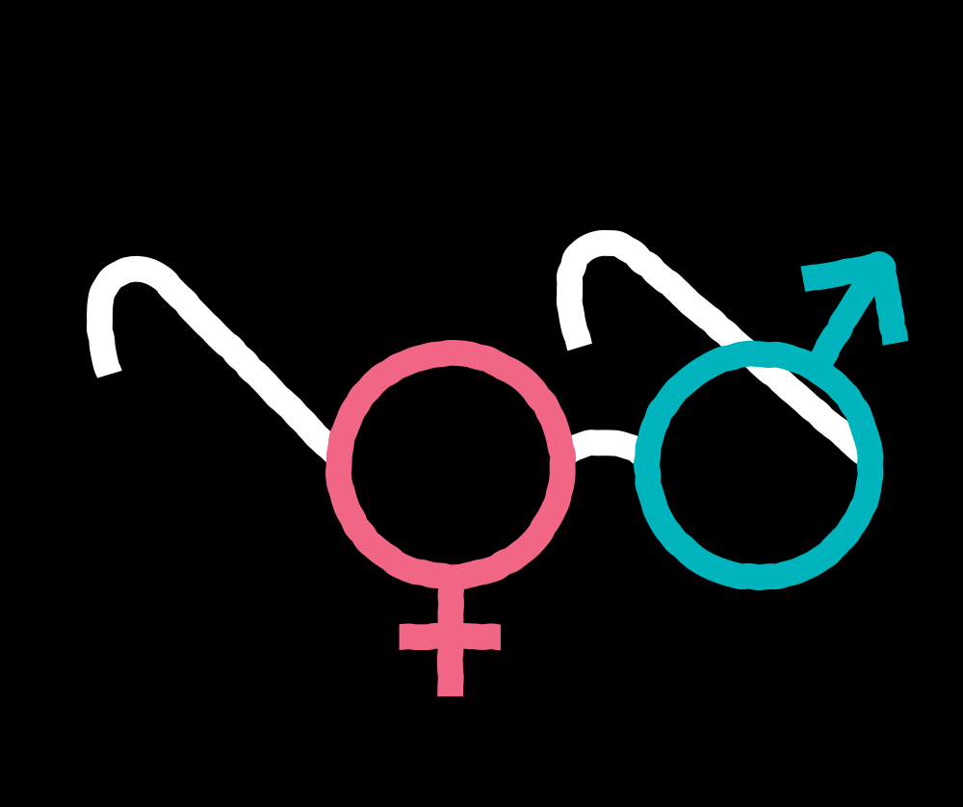

Slide 20
Conclusion
So, let us go back to our initial question: what do you mean or what are you referring to when you say, ‘I am a girl’ or ‘I am a boy’?
Why is this important? Gender affect our self-awareness, emotional development and lived realities.
Further questions: why do we care so much about the binary?

Slide 21
When we speak about ‘sex’ as biological category —where can we locate it and how? And who decides this?
The idea of ‘sex’ being socially constructed is not that biology doesn’t exist…of course we are all biologically different… but it is that there are no 2 categories into which everyone can cleanly fit into…
We hold the binary understanding to such high regards that we perform surgeries on children to ‘correct’ their gender or force children to look, behave, think in specific ways.
Moreover, why do we want to divide the world based on genitals and not something else?

